Slide 1
Who’s Watching TV? Algorithm For Analyzing TV Watching Sequence
Zheng Wang, Tianwan Zhao, Kenny Zhu

Slide 2
Motivation
We need to recommend different content to family members respectively
Identify how many persons in the family
Profile the preference for each of them
For census company, provide useful information about this family
How many persons? What’s their ages distribution?
Detect special families like empty nesters family
Notes:
Empty-nesters

Slide 3
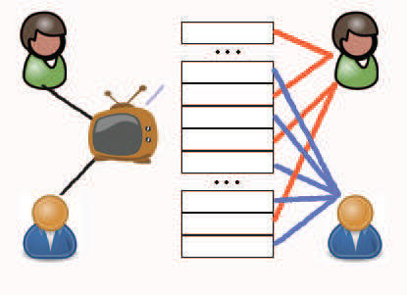
Problem Definition
Given a sequence of viewing sequence
Find how many persons are in front of TV
Assign each record in the sequence to the right viewer

Slide 4
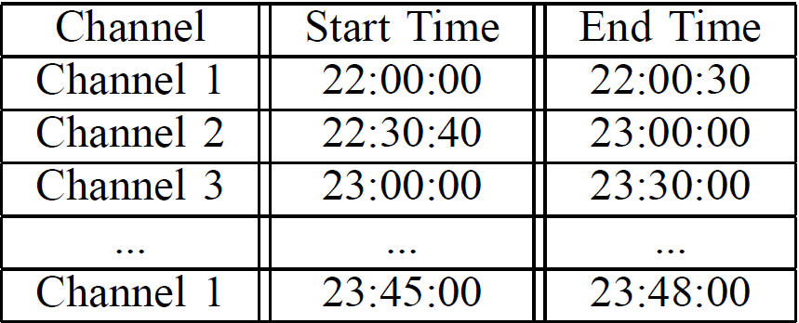
Problem Definition Cont.
What’s viewing sequence?
Consists of 3-dimension tuples-<Channel, ST, ET>
Arranged according to ST dimension

Slide 5
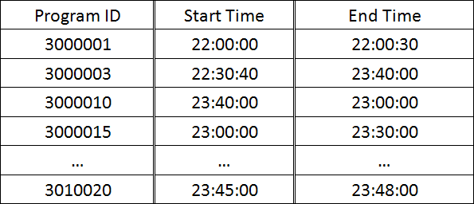
Data Preprocess
Channel Provides little information
From Channel to Program

Slide 6
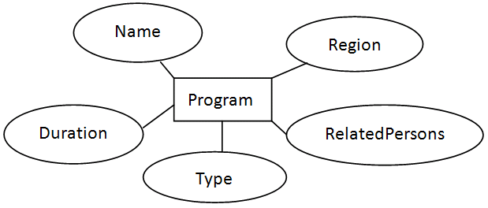
Baseline Approach
Content-based
Use program model to generate similarity matrix
E.g. Men in black ,Lord of war and news report
Unsupervised
Use HAC clustering to assign each record to correct user.
How many users?

Slide 7
Baseline Approach Cont.
Find the number of viewers
Usually, there are less than 5 persons in a family.
Force HAC algorithm to generate k clusters.
We compare the confidence of the clustering result with regard to different k value.

Slide 8
Baseline Approach Cont.
Discussion
Computation is not very expensive and parallelism is possible
Ceiling value could be configured.

Slide 9
Baseline Approach Cont.
Two main drawbacks of baseline approach
A single user has multiple interests
Baseline approach could NOT identify it.
Two different users share a common interest
Baseline approach could NOT identify it.

Slide 10
Our Approach
Improve previous framework by probability model
When generating similarity matrix, we use the probability that these two programs are viewed by the same viewer instead of their content-similarity.

Slide 11
Our Approach Cont.
Heuristic 1:If tow programs are watched continuously, then they are likely watched by a single viewer.

Slide 12
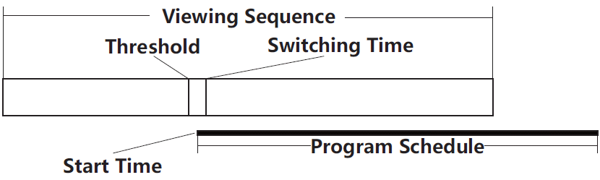
Our Approach Cont.
Heuristic 2:If two programs are watched continuously and the switching time is the start time(almost) of the second program, then they are more probably watched by a single viewer.

Slide 13

Our Approach Cont.
Mining Prior Knowledge
Train the two prior knowledge implied by Heuristics 1 and Heuristics 2
Supervised Learning
Label sample viewing sequences manually
Based on the labeled data:
Calculate P(S|A,B)
Empirical Value
Heuristics 1: 70% and Heuristics 2: 98%

Slide 14
Our Approach Cont.
Using Markov chain model to generate more probability information
E.g. Program A, B, C are continuous to each other.
Markov chain model is suitable here!

Slide 15
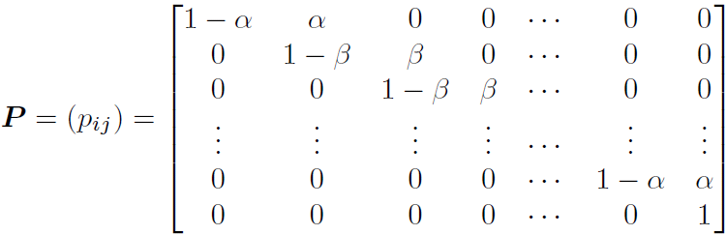
Our Approach Cont.
Transition Matrix in our problem
αandβ represents prior probability respectively

Slide 16

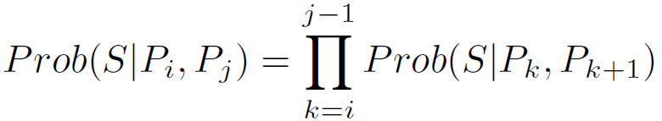
Our Approach Cont.
According to Markov chain theory
Because of the special form of the transition matrix

Slide 17
Our Approach Cont.
Building Attribute Co-Occur Matrix
We want probability that the two program viewed by the same viewer for every program pair.

Slide 18
Our Approach Cont.
Basic Idea
P(S|A,B) could be used as the program attributes’ similarity between these two programs.
E.g. P(S|(men in black),(lord of war) ) = 0.98
P(S|(Will Smith),(Nicolas Cage)) = 0.98
Content-based
Use program model as mentioned before

Slide 19
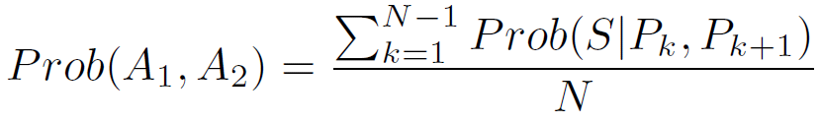
Our Approach Cont.
Implementation
We have two attributes A₁ and A₂, and there are N programs containing these two attributes. That is, P₁,P₂,· · · ,P_{n}. Then:
Knowledge transformation
Converge all prior knowledge in to one co-occur matrix

Slide 20
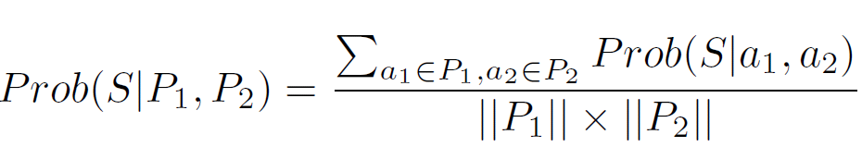
Our Approach Cont.
Final Model
Using the attribute Co-Occur matrix, we could model the final probability as follows:

Slide 21
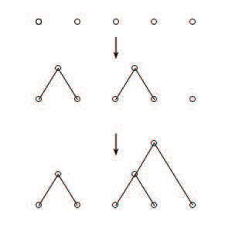
Our Approach Cont.
Clustering
Use probability Prob(S|A, B) as the input to the clustering algorithm
Choose to use HAC
Having distance is enough
Can control the number of clusters

Slide 22
Our Approach Cont.
How many persons?
Same as before
Try and remember best

Slide 23
Evaluation
Best match algorithm
Perfect 100% and Worst (100/k)%
Penalty on empty set
Example
{A,B} {C,D} {E,F,G}
{A,B,C} {D,E,F,G}
A,B,E,F,G best match
Precision: 71.4%

Slide 24
Experimental Setup
Random Selection
4 test groups each has 4 test cases
2-persons, 3-persons, 4-persons, 5-persons
Generated data instead of real data
Hard to collect real data
Generation method is not partial to our algorithm and meaningful

Slide 25
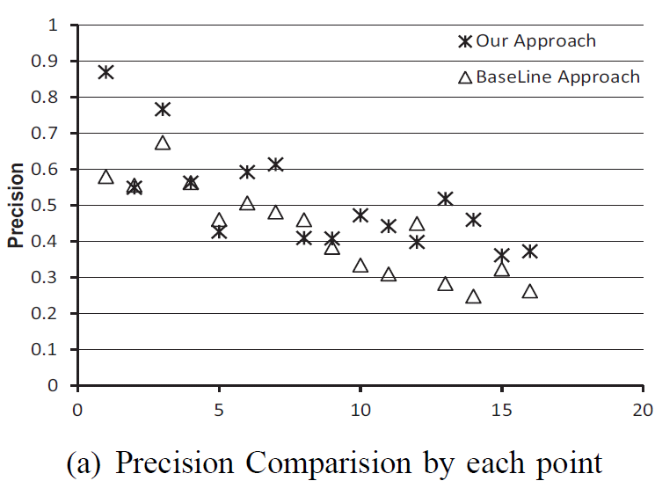
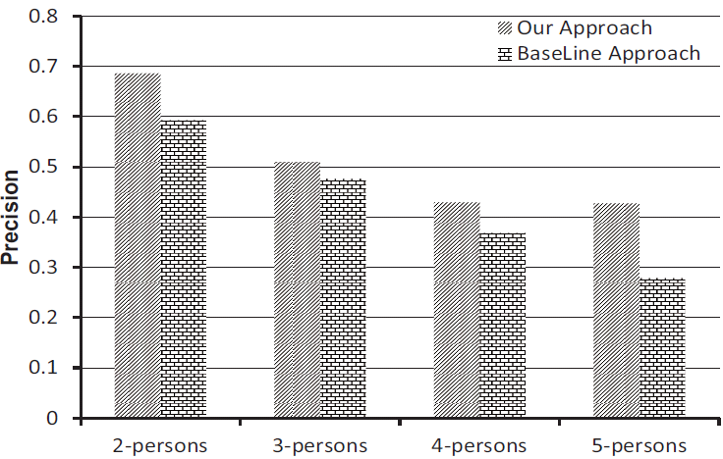
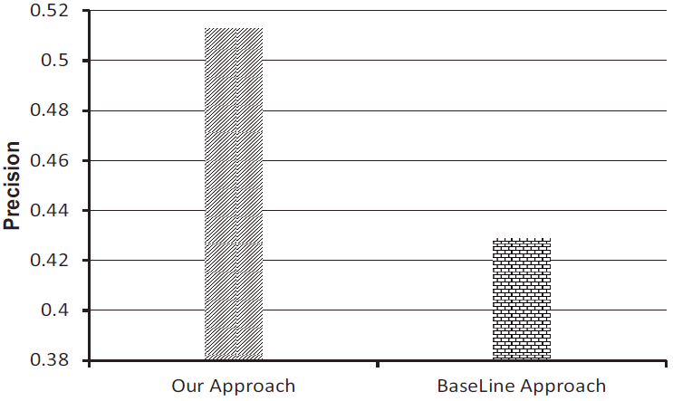
Experimental Result

Slide 26
Thank you! & QA

